Slide 1

Presentation on
Development
of
Timetable Generation System
Made By- Omkar Rasal -2215023
Poornima Andhare -2215024
Vishal Shinde -2215036
Prathamesh Panchmire -2215056

Slide 2

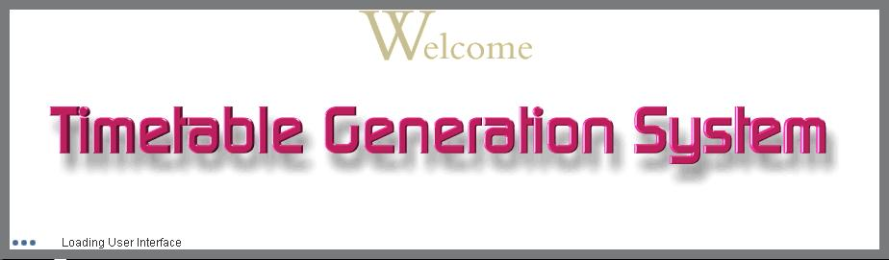

Slide 3
Introduction
The Problem is to Manage the Time Table of the all class of the college according to teacher, and the Purpose of Manage Timetable of the College is, for any College Teacher timetable scheduling is a very arduous and time-consuming task. College Timetable management module helps you to generate class time table as well campus and teacher time table. Time table management module organizes the campus week, holidays, breaks in between classes and subject teacher. Timetable Management module automatically creates your Campus Timetable for classes, class teachers and students.

Slide 4
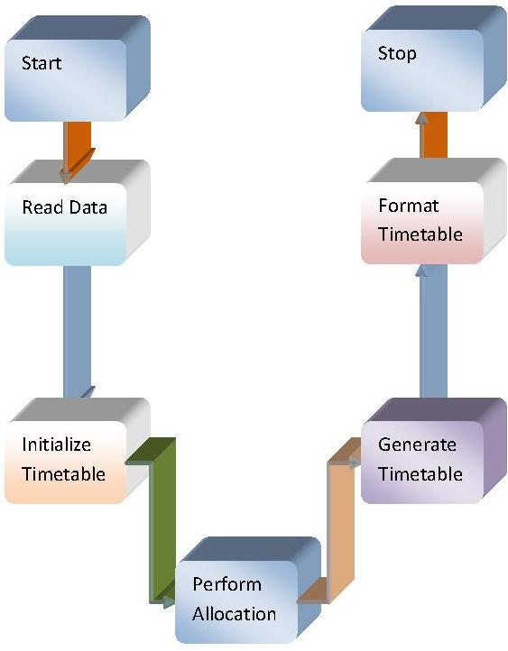
Flow of Data Within Project
Collect data from data store
Initialize Timetable
Perform Allocation
Generation of Timetable
Formatting of Timetable

Slide 5
Project Flow
Stage-I
Stage-II
Literature Survey
  Timetabling Algorithms
  Search for existing applications
Analysis
  Requirement of Project
  Flow of project
Planning
Implementation
  Main Timetable Generator Coding
  Export to HTML

Slide 6



It Consist Of Scheduling Of Lectures And Rooms
Based On Strong Constraints and Weak Constraints in given Time Slots
Strong Constraint
A classroom is not assigned to more than one lecture at the same time.
Weak Constraint
There should be break after 2 hrs
A teacher can take maximum 3 lectures a day

Slide 7







Teachers List
Subjects List
Rooms List
A
B
C
D
E
DM
OS
Java Lab
DS
SHD
R1
R2
R3
R4
Time Slots List
Years List
Days List
9:00-9:50
.
.
1:45-2:35
2:35-3:25
3:25-4:15
I
II
III
IV
Mon
Tue
Wed
Thu
Fri

Slide 8
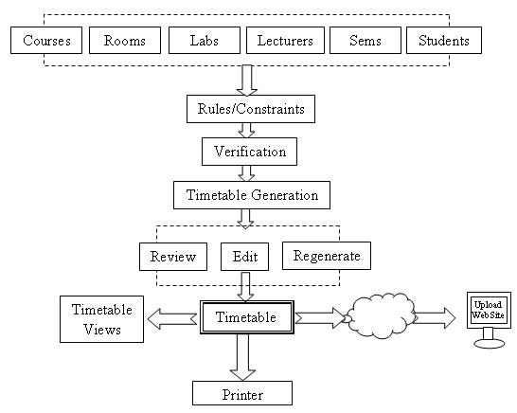

Slide 9
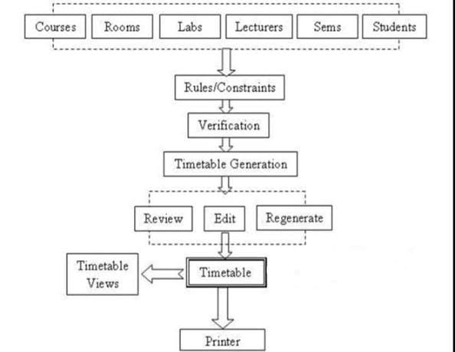

Slide 10
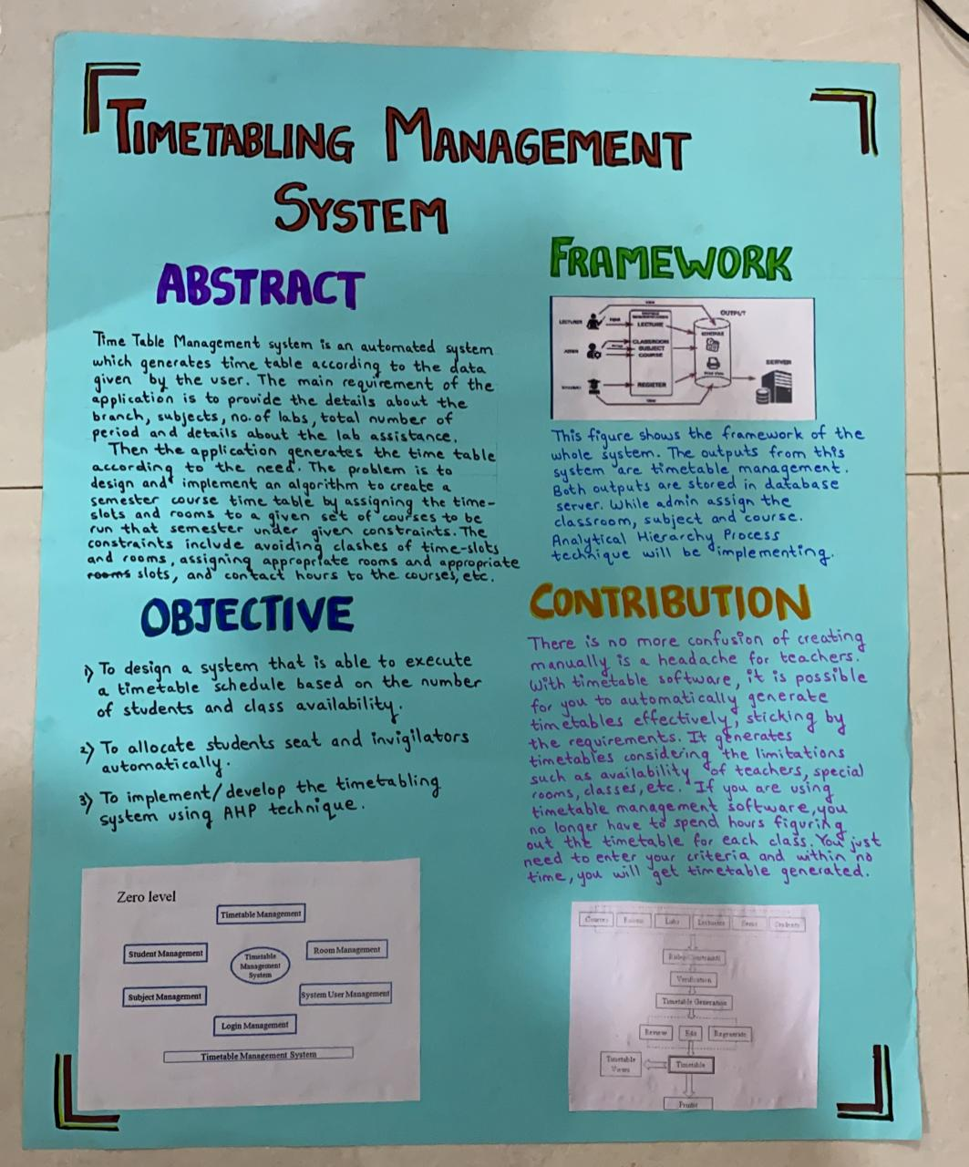

Slide 11
Timetable Generation System
Timetabling The Stress Free Way !
Thank You !

